Slide 1
Session 03: Review API Services and methods. Queries
May 7th, 2013
Brian Laskey, Senior Software Engineer, IBM

Slide 2
Please Note
IBM’s statements regarding its plans, directions, and intent are subject to change or withdrawal without notice at IBM’s sole discretion.
Information regarding potential future products is intended to outline our general product direction and it should not be relied on in making a purchasing decision.
The information mentioned regarding potential future products is not a commitment, promise, or legal obligation to deliver any material, code or functionality. Information about potential future products may not be incorporated into any contract. The development, release, and timing of any future features or functionality described for our products remains at our sole discretion.
Performance is based on measurements and projections using standard IBM benchmarks in a controlled environment. The actual throughput or performance that any user will experience will vary depending upon many factors, including considerations such as the amount of multiprogramming in the user’s job stream, the I/O configuration, the storage configuration, and the workload processed. Therefore, no assurance can be given that an individual user will achieve results similar to those stated here.
Notes:
IBM IOD 2011
Prensenter name here.ppt

Slide 3
Query Service
Specification and execution of complex queries against the OpenPages model
Query Syntax: Subset of SQL- 92
  SELECT Only
Queries are expressed by this SQL-like syntax rather than through complex Java structures.
Queries are specified in terms of object model types:
  RiskAssessment, SOXBusEntity, SOXRisk, etc.
Query Service converts the SQL expression and translates to physical DB tables
  [FieldGroup:Fields] → columns
  [Object Types] → tables
API is used to consume result sets row by row.
Minimize memory consumption of returned data by the client (paging, iterators)

Slide 4
Query Service Capabilities
Select which data (Fields) to retrieve, only retrieve that data
Hierarchical queries may span multiple associated types (support for JOIN)
Support for recursive types (Business Entity)
Return all field types, fields from different objects in a single row
Filter on all field types, i.e. Currency, Drop Downs, Strings
  Which operators are available depends on data type
Sorting on field
Filter By Primary Associations
Like/Contains, Long String search
Paging of Results

Slide 5
Query Service Implementation
New Service not based on OPSDK directly.
Below is for information only, not exposed to API developers
Queries are parsed using ANTLR 3.4 (3rd party library)
Parsing results into “Query Object” that describes the request based on the tokens and syntax we defined. Query Object is then used to dynamically construct query on physical DB tables.
  API define our custom SQL in ANTLR syntax
  API internally defines Query Object and mapping of Query Object to physical model.
Uses the “RV” Reporting Schema views for filtering and retrieval of values
  Modeled after SQL from hierarchical findResources from OPSDK
  Respects OpenPages security, including Record Level Security Rules

Slide 6
Query Syntax
Like a SQL SELECT statement
    SELECT [Columns]… identified by [Object Type].[Field Name]
    Or [Object Type].* for all fields
    FROM [Object Type]
    Optional use JOINs for parents/children:
    JOIN [Parent Object Type] ON PARENT([Object Type] )
    Optional any filters on fields
    WHERE
    [Object Type].[Field Name] LIKE ‘abc’ AND
    [Object Type].[Field Name] = 123
    Optional a sort order
    ORDER BY

Slide 7
Query Example
For Controls with Ineffective Controls:
  Query Control
    SELECT
    [SOXControl].[Resource ID],
    [SOXControl].[Name],
    [SOXControl].[OPSS-Ctl:Operating Effectiveness]
    FROM [SOXControl]
    WHERE
    [SOXControl].[OPSS-Ctl:Operating Effectiveness] = 'Ineffective'

Slide 8
Old API vs New API:
Search for child Issues, two levels below an Entity
// get ContentTypeIds
ContentTypeId entityTypeId = ms.getContentTypeId("SOXBusEntity");
ContentTypeId riskEntityTypeId = ms.getContentTypeId("SOXProcess");
ContentTypeId riskTypeId = ms.getContentTypeId("SOXIssue");
// set id
ResourceSet set = (ResourceSet) rs.getSets().get(0);
LabelId currentRP = rs.getLabel("Current Reporting Period").getLabelId();
// use hierfindresources to get Issue under this entity
// (Entity -> Process -> Issue)
HierFindResourceOptions hierFindResourcesOptions = new HierFindResourceOptions();
hierFindResourcesOptions.setIncludeSubFolders(true);
hierFindResourcesOptions.setIncludeCustomProperties(true);
hierFindResourcesOptions.setIncludeLocks(false);
hierFindResourcesOptions.setIncludeVersion(true);
hierFindResourcesOptions.setReturnType(riskTypeId);
hierFindResourcesOptions.setIsTopDown(true);
hierFindResourcesOptions.setHonorPrimaryAssociation(false);
hierFindResourcesOptions.setScopeResourceId(entityId);
hierFindResourcesOptions.setLabelId(currentRP);
hierFindResourcesOptions.setSetId(set.getSetId());
// set the content type criteria for the possible paths to Risk from
// Entity
ContentTypeCriteria entityObjectCriteria = new ContentTypeCriteria(
entityTypeId);
entityObjectCriteria.setRecurseContentType(true);
hierFindResourcesOptions.addCriteria(entityObjectCriteria);
//Process
ContentTypeCriteria reObjectCriteria = new ContentTypeCriteria(
riskEntityTypeId);
reObjectCriteria.setRecurseContentType(false);
hierFindResourcesOptions.addCriteria(reObjectCriteria);
//Issue
ContentTypeCriteria rootCopyObjectCriteria = new ContentTypeCriteria(
riskTypeId);
rootCopyObjectCriteria.setRecurseContentType(false);
hierFindResourcesOptions.addCriteria(rootCopyObjectCriteria);
//add a sort
QuerySortOrder nameAscendingSort= new QuerySortOrder();
BundleTypeId systemBundle = ms
.getBundleTypeId(MetadataConstants.SYSTEM_FIELDS_BUNDLE_NAME);
PropertyTypeId systemNameProperty = ms.getPropertyTypeId(systemBundle,
MetadataConstants.SYSTEM_FIELDS_BUNDLE_NAME_PROP);
nameAscendingSort.setContentTypeId(riskTypeId);
nameAscendingSort.setIsNullFirst(false);
nameAscendingSort.setPropertyTypeId(systemNameProperty);
nameAscendingSort.setDirection(SearchConstants.ASC);
hierFindResourcesOptions.addSortOrder(nameAscendingSort);
//return a list of issues
List<Resource> issues = (List<Resource>) rs
.findResources(hierFindResourcesOptions);
String statement = "SELECT [SOXIssue].* " +
"FROM [SOXIssue] " +
JOIN [SOXRisk] ON CHILD([SOXIssue]) "+
"JOIN [SOXBusEntity] ON CHILD([SOXRisk]) " +
"WHERE [SOXBusEntity].[Resource ID] = "+entityId +
" ORDER BY [SOXIssue].[Name]";
IQuery query = queryService.buildQuery(statement);
ITabularResultSet resultset = query.fetchRows(SKIP_NONE);

Slide 9
When to use QueryService
Need to query single object type that meets some straight forward criteria
  Like FLV filters
  Only need to bring back the data you need
Need to get fields from several related object types at once
  All the data you want to use is contained in a single row
  Such as simple Cognos Reports

Slide 10
Using QueryService API
Interface: com.ibm.openpages.api.service.IQueryService
buildQuery(java.lang.String sqlStatement)
Query defined in sqlStatement using a String that follows the SQL statement syntax we specify
Package for related public interfaces
  com.ibm.openpages.api.query
buildQuery() returns an instance of IQuery
Can set additional parameters on IQuery interface
To execute the query, use IQuery.fetchRows()
Consume the results using ITabularResultSet

Slide 11
Example QueryService Java usage
IServiceFactory serviceFactory = ServiceFactory.getServiceFactory(context);
//create Query Service
IQueryService queryService = serviceFactory.createQueryService();
String query = "SELECT [Resource ID], [Name] FROM [SOXIssue]";
IQuery query = queryService.buildQuery(query);
ITabularResultSet resultset = query.fetchRows(0);
for (IResultSetRow row : resultset) {
// process rows...
for (IField field : row) { // process fields
... }
... }

Slide 12
QueryService – Result Sets
ITabularResultSet implements Iterable<IResultSetRow> interface
  Can use directly in for() loops.
Iterates over any IResultSetRow found until no rows remain.
Transparently gets the next Page if IQuery’s page size > 0 (0 is all rows)
IResultSetRow itself implements Iterable<IField>, every column of the results is an IField instance.
Same IField interface from ResourceService, can be cast to the data type to retrieve the value.

Slide 13
QueryService – Other Query Parameters
IQuery interface has parameters which impact the query results returned
setHonorPrimary(boolean honorPrimary)
  Whether to only traverse primary parent associations or all associations
  Default is false
setReportingPeriod(IReportingPeriod reportingPeriod)
  Default to Current Reporting period
setPageSize(int pageSize)
  Default is 50 rows per page, 0 is no paging
setMaxRows(int maxRows)
  To restrict how many total rows to return i.e. “only get first 10”
  Default is unlimited
setCaseInsensitive(boolean caseInsensitive)
  For string comparison operators perform comparison case insensitive
  Default is false (case sensitive)

Slide 14
QueryService – Paging
Can also iterate over the ITabularResultSet page by page using getPages() which returns a list of IPage interfaces. IPage is iterable for IResultSetRow
Example using Paging:
IQuery query = queryService.buildQuery(query);
// Execute query and fetch results.
ITabularResultSet resultset = query.fetchRows(0);
for (IPage page : resultset.getPages()) {
// process page...
for (IResultSetRow row : page) {
// process each row...
for (IField field : row) { // process each field... }
}
}

Slide 15
Query Service Syntax
Overview for Query Service SQL syntax

Slide 16
SELECT clause
SELECT
The SELECT must contain one of the following:
A comma separated list of one or more field system names: the query result set include in its row set all the fields specified in the SELECT clause.
*: The query result set include in it’s row set all the fields of the qualifying object type or the object type specified in the FROM clause.
In addition, all column names specified must be valid field names. – (Case Sensitive)
Followed by FROM Clause
    SELECT [SOXProcess].[Resource ID],
    [SOXProcess].[Name],
    [SOXRisk].[Resource ID],
    [SOXRisk].[Name],
    [SOXControl].[Resource ID],
    [SOXControl].[Name],
    [SOXControl].[OPSS-Ctl:Operating Effectiveness]

Slide 17
Naming Conventions
When Specifying Field Names, use the System Name
Also the name provided by MetaData
Format is:
  Field Group:Field Name
Exception is System Fields i.e. Name, Resource ID. The following are the names to identify these fields in the query
  Resource ID - Last Modification Date
  Comment - Last Modified By
  Created By - Location
  Creation Date - Name
  Description
All identifiers referencing the name of a field need to be delimited by a [ ]. The use of the square bracket allows for names to contain spaces.
[Resource ID], [OPSS-ISS:Status]

Slide 18
Naming Conventions
Unqualified column names
A column name does not need to be qualified if there is only one type included in the SQL query.
The following example demonstrates the column name (Resource ID) which is not qualified.
SELECT [Resource ID]
FROM [SOXBusEntity]
Qualified column names
A column name can be formed by qualifying its type name.
The following example demonstrates the column name (Resource ID) which is qualified by its type (SOXBusEntity).
SELECT [SOXBusEntity].[Resource ID]
FROM [SOXBusEntity]

Slide 19
FROM clause
FROM
The FROM clause identifies which Object type the query will be run against. The FROM clause must contain only one object type name that is available from the model.
Optional - Followed by JOIN Clause
Example:
FROM [SOXBusEntity]

Slide 20
JOIN clause
JOIN
The JOIN clause is used to combine fields from multiple objects types into a single result set. It is also how navigation between types is expressed. The JOIN clause differs slightly from the SQL-92 standard.
The JOIN clause is expressed between object types with the ability to specify a CHILD/PARENT function to indicate the direction of traversal.
Further more when defining a self JOIN (recursive), a level may be included in the function as an additional parameter.

Slide 21
JOIN Examples
Simple three level hierarchy
Entity
LevelOne
LevelTwo

Slide 22
Top down JOIN
The top down traversal JOIN means you are joining starting from a parent to a child.
Example:
For the following example the SOXBusEntity type is a parent of the LevelOne type and LevelOne is the parent of LevelTwo
SELECT [SOXBusEntity].[Name], [LevelOne].[Name], [LevelTwo].[Name]
FROM [SOXBusEntity]
JOIN [LevelOne] ON PARENT([SOXBusEntity])
JOIN [LevelTwo] ON PARENT([LevelOne])
FROM [SOXBusEntity]
The FROM clause indicates the starting point in the traversal, SOXBusEntity
JOIN [LevelOne] ON PARENT([SOXBusEntity])
This join expresses the relationship between LevelOne and SOXBusEntity. In other words LevelOne is joining to SOXBusEntity via a PARENT association.
JOIN [LevelTwo] ON PARENT([LevelOne])
This join expresses the relationship between LevelTwo and LevelOne. In other words LevelTwo is joining with LevelOne via a PARENT association

Slide 23
Bottom Up JOIN
The bottom up traversal JOIN means you are joining starting from a child to a parent.
Example:
For the following example the SOXBusEntity type is a parent of the LevelOne type and LevelOne is the parent of LevelTwo
SELECT [SOXBusEntity].[Name], [LevelOne].[Name], [LevelTwo].[Name]
FROM [LevelTwo]
JOIN [LevelOne] ON CHILD([LevelTwo])
JOIN [SOXBusEntity] ON CHILD([LevelOne])
FROM [LevelTwo]
The FROM clause indicates the starting point in the traversal, LevelTwo
JOIN [LevelOne] ON CHILD([LevelTwo])
This join expresses the relationship between LevelOne and LevelTwo. In other words LevelOne is joining with LevelTwo via a CHILD association.
JOIN [SOXBusEntity] ON CHILD([LevelOne])
This join expresses the relationship between SOXBusEntity and LevelOne. In other words SOXBusEntity is joining with LevelOne via a CHILD association.

Slide 24
Recursive Join
The recursive traversal JOIN means you are joining performing a self join. In other words you are joining on a parent/child of the same type.
Recursive traversal also extends the syntax of the PARENT/CHILD function.
A level constraint may be included to specify which level to include in the join. When no values are specified in the function, it uses the default which is zero and will include all levels. Any other positive integer value will constrain the traversal for that level.
JOIN [SOXBusEntity] AS [child_be] ON PARENT([SOXBusEntity])
is equals to
JOIN [SOXBusEntity] AS [child_be] ON PARENT([SOXBusEntity], 0)

Slide 25
Recursive – What are the levels?
Assume this hierarchy
Go from E1 to Processes
  SELECT [SOXProcess].[Resource ID]
  FROM [SOXBusEntity]
  …
  WHERE [SOXBusEntity].[Name] = ‘E1’
E1
E2
P1
E3
P2
E4
P3

Slide 26
Recursive – What are the levels?
JOIN [SOXBusEntity] AS [a] ON PARENT([SOXBusEntity], 0)
  All recursive entity levels considered
E1
E2
P1
E3
P2
E4
P3

Slide 27
Recursive – What are the levels?
JOIN [SOXBusEntity] AS [a] ON PARENT([SOXBusEntity], 2)
  Only two levels below E1 will be traversed
E1
1
E2
P1
2
E3
P2
E4
P3
This is the behavior of the SDK’s FindResources setLevels()

Slide 28
WHERE clause
Comparisons permitted in the WHERE clause
Basic comparison predicate (=, <>, <, >, >=, <= ) , IN predicate, LIKE predicate, IS NULL predicate,
(AND), (OR), and negation (NOT) of predicates are also supported.
The CONTAINS function is also supported for long text field when database indexing has been enabled.
Depending on the Data Type of the Field, different predicates are supported. Refer to the Query package javadoc
WHERE [SOXIssue].[OPSS-Iss:Status] = 'Open' AND [SOXIssue].[OPSS-Iss:Additional Description] IS NOT NULL

Slide 29
LIKE Predicate
The LIKE predicate is used in a WHERE clause to search for a specified pattern in a field value. Single quotes are used to enclose the search pattern. The "%" sign is used to define wildcards both before and after the pattern.
For Date field type, LIKE predicate is not supported.
For currency field type, the base amount of the currency is used for the pattern search.
For enum/multi-enum field types, the enum value is used for the pattern search.
All other field types are supported.
Example:
SELECT [Resource ID], [Name]
FROM [SOXBusEntity]
WHERE [Name] LIKE ‘%entity%’

Slide 30
IN Predicate
The IN predicate compares a value or values with a collection of values. The values for expression1 and expression2 in the IN predicate must be compatible. If NOT is specified, the result is reversed.
For date field type, the Date string format needs to be specified.
  Example:
[Creation Date] IN (‘2013-05-16’, ‘2013-05-18’)
For enum or multi-enum field types, a string representing the system name of the enum value delimited by single quotes may be used or the enum value identifier.
  Example:
  by enum value name:
  [Shared:Shared Drop Down] IN (‘New York’, ‘Rhode Island’)
  by enum value id:
  [Shared:Shared Drop Down] IN (4215, 4218)
For large text string field type, the IN clause is not supported.
All other field types are supported.

Slide 31
Enum Type Fields
As mentioned in the previous slides. For enum or multi-enum field types, a string representing the system name of the enum value delimited by single quotes may be used or the enum value identifier.

Slide 32
Currency
      Currency Field
A Currency field is composite type that is composed of the following values:
  base amount
  base currency
  exchange rate
  local amount
  local currency
Result Column is represented as ICurrencyField with all these attributes.
For the purpose of constraining the result set using a currency field, the base amount will used as the constraining fields. Other fields are ignored.
Example:
This example demonstrates the use of a currency field named Shared:Shared Currency field to apply a filter in the WHERE clause. The field base amount will be used for filtering.
SELECT [Shared:Shared Currency]
FROM [LevelOne]
WHERE [Shared:Shared Currency] = 5.0

Slide 33
Dates
The Date string format supported by the Query Service is “yyyy-MM-dd”.
Example:
SELECT [Creation Date]
FROM [SOXBusEntity]
WHERE [Creation Date] = ‘2013-05-16’

Slide 34
Long String
The Long String data types are persisted through a different mechanism than String fields. Data is stored in CLOB columns.
Doing text search requires text indexing to be installed and enabled at the RDBMS level (Refer to installation documentation for Oracle and DB2 steps)
CONTAINS function operator can be used to search text matches.
  Note this is always case-insensitive regardless of the query option
Example:
SELECT [Shared:Shared Large On Demand]
FROM [SOXIssue] "
WHERE CONTAINS([Shared:Shared Large On Demand], ‘text')

Slide 35
ORDER BY clause
ORDER BY
This clause MUST contain a comma separated list of one or more column names. All column names referenced in this clause must be valid “system name”.
Only columns in the SELECT clause MAY be in the ORDER BY clause. Ordering is impacted by collation rules defined by the OpenPages schema.
After each column name, may have the direction to sort: ASC , DESC
SELECT [SOXBusEntity].*
FROM [SOXBusEntity]
ORDER BY [SOXBusEntity].[Name] DESC

Slide 36
Advanced Features
UNION
Use this to union the results of two SELECT queries in a single execution. As in SQL, both SELECT clauses must return the same columns
Example
SELECT [SOXIssue].[Resource ID]
FROM [SOXBusEntity]
JOIN [SOXIssue] ON PARENT([SOXBusEntity])
WHERE [SOXBusEntity].[Name] LIKE '%Test 01%'
UNION
SELECT [SOXIssue].[Resource ID]
FROM [SOXBusEntity]
JOIN [LevelOne] ON PARENT([SOXBusEntity])
JOIN [SOXIssue] ON PARENT([LevelOne])
WHERE [SOXBusEntity].[Name] LIKE '%Test 01%'

Slide 37
Advanced Features
Outer Join
Use to perform left outer join, default JOIN clause is inner join, this returns rows in cases where multiple objects are being joined and some rows do not have all parents/children
Example
SELECT [SOXBusEntity].[Name], [LossEvent].[Name]
FROM [SOXBusEntity]
OUTER JOIN [LossEvent] ON PARENT([SOXBusEntity])
Entity Name | LossEvent Name
Global Financial Services | LE_00123
Commercial Banking | LE_00123
Retail Banking | null

Slide 38
Query Example
Illustration of joins, returning multiple types, filtering on Enum field
For Risk as Direct child of Process with Ineffective Controls:
  Query Gets Process -> Risk -> Control
    SELECT [SOXProcess].[Resource ID],
    [SOXProcess].[Name],
    [SOXRisk].[Resource ID],
    [SOXRisk].[Name],
    [SOXControl].[Resource ID],
    [SOXControl].[Name],
    [SOXControl].[OPSS-Ctl:Operating Effectiveness]
    FROM [SOXProcess]
    JOIN [SOXRisk] ON PARENT([SOXProcess])
    JOIN [SOXControl] ON PARENT([SOXRisk])
    WHERE
    [SOXControl].[OPSS-Ctl:Operating Effectiveness] = 'Ineffective'

Slide 39
Query Example
1. Basic query, get all fields for an object type. Use [*] to avoid having to list every field. Ideally you would only bring back data that you will use, so use with care.
SELECT [KeyRiskIndicatorValue].[*] FROM [KeyRiskIndicatorValue]
b) Add a WHERE clause filter
SELECT [SOXIssue].[*] FROM [SOXIssue] WHERE [SOXIssue].[OPSS-Iss:Status] = 'Open'
c) And add multiple filters with AND/OR operators
SELECT [SOXIssue].[*] FROM [SOXIssue] WHERE [SOXIssue].[OPSS-Iss:Status] = 'Open' AND [SOXIssue].[OPSS-Iss:Additional Description] IS NOT NULL

Slide 40
Query Example
2. Hierarcical Search. To retrieve multiple object types in one query based on the associations. For example get KRI Values under a specific Risk(s) where KRI Red Threshold > 20
SELECT [SOXRisk].[Location], [KeyRiskIndicator].[Name],[KeyRiskIndicator].[OPSS-KRI-Shared:Red Threshold], [KeyRiskIndicatorValue].[Name], [KeyRiskIndicatorValue].[OPSS-KRIVal:Value]
FROM [SOXRisk]
JOIN [KeyRiskIndicator] ON PARENT([SOXRisk])
JOIN [KeyRiskIndicatorValue] ON PARENT([KeyRiskIndicator])
WHERE
([SOXRisk].[Name] = 'RI-0019' AND
[KeyRiskIndicator].[OPSS-KRI-Shared:Red Threshold] >= 20)
OR ([SOXRisk].[Name] = 'RI-0020')

Slide 41
Query Example
3. Using LIKE to search for text (Simple String or Long String fields)
SELECT [SOXRisk].[Name], [SOXRisk].[Description]
FROM [SOXRisk]
WHERE [SOXRisk].[Description] LIKE '%Physical Assets%'

Slide 42
Query Example
4. Recursive types, SOXBusEntity and direct SOXBusEntity children under root level entity 'Global Financial Services'
SELECT [SOXBusEntity].[Name], [child_be].[Name]
FROM [SOXBusEntity]
JOIN [SOXBusEntity] AS [child_be] ON PARENT([SOXBusEntity], 1)
WHERE [SOXBusEntity].[Name] = 'Global Financial Services'
Note To return all levels, just remove '1' from the ON PARENT([SOXBusEntity]) clause.

Slide 43
Query Example
5. Multiple Direction Query
KRI is child of Business Entity
KRI is also child of Risk
Entity
Risk
KRI

Slide 44
Query Example
Join Entity to KRI and KRI to Risk.
SELECT [SOXBusEntity].[Name], [KeyRiskIndicator].[Name],[SOXRisk].[Name]
FROM [SOXBusEntity]
JOIN [KeyRiskIndicator] ON PARENT([SOXBusEntity])
JOIN [SOXRisk] ON CHILD([KeyRiskIndicator])
WHERE [KeyRiskIndicator].[Name] LIKE 'KRI-0001‘
Returns:
STRING_TYPE STRING_TYPE STRING_TYPE
Retail Banking KRI-0001 RI-0019

Slide 45
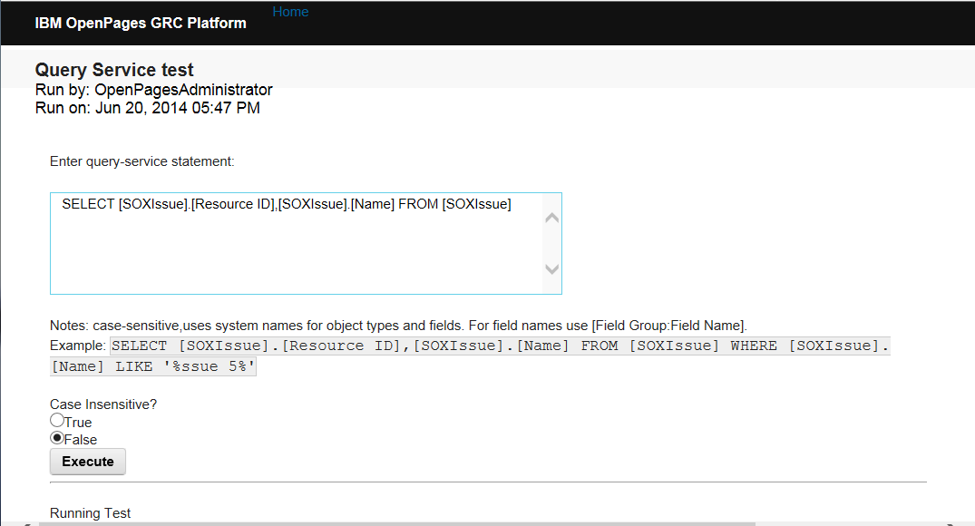
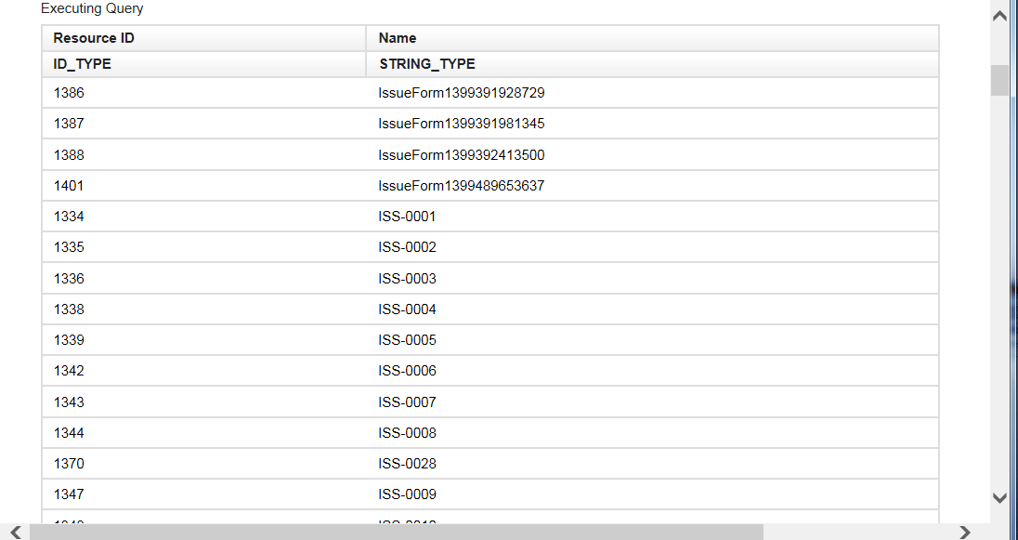
Developing and Debugging
Suggest that you first write queries and test them in provided sample JSP. See API samples “QueryTestJSP”

Slide 46
Advanced: Finding the queries being run on the database
For debug only, to find timings for different operations of the query service, and to find the physical SQL being on the database, you may enable additional logging
In <OP_HOME>/aurora/conf/auroralogging.properties add the following lines
log4j.category.com.ibm.openpages.aurora.service.repository.resource=DEBUG#com.openpages.aurora.common.logging.Log4jEventLoggerLevel, QUERYlog4j.category.com.ibm.openpages.service.query.impl=DEBUG#com.openpages.aurora.common.logging.Log4jEventLoggerLevel, QUERY
log4j.appender.QUERY=org.apache.log4j.RollingFileAppenderlog4j.appender.QUERY.File=${openpages.home}/aurora/logs/${openpages.instance}-query.loglog4j.appender.QUERY.MaxFileSize=1024KBlog4j.appender.QUERY.MaxBackupIndex=10log4j.appender.QUERY.Threshold=DEBUG#com.openpages.aurora.common.logging.Log4jEventLoggerLevellog4j.appender.QUERY.layout=com.openpages.aurora.common.logging.Log4jEventLoggerPatternLayoutlog4j.appender.QUERY.layout.ConversionPattern=%d{DATE}%n%-5p %b on %h%n%m%n[%t](%F:%L)%n%n

Slide 47
Considerations
Currently does not support all database functions or operators
No aggregations – Min, Max, Count – No Group By
No Other Database Functions in the syntax yet (Date/Time functions, String manipulation, or expressions).
IN, LIKE and = are case sensitive by default.
  As of v7.1 Can specify case insensitive search for Strings. Can also use wildcards with LIKE %, _
  Contains is also case insenstive
Does not support nested “sub-select” in either SELECT, FROM or WHERE
All join “path” must be explicitly given. Multiple alternate paths require additional UNION.
Queries will execute against Reporting Schema tables in the database. Filtering on a non-indexed column performance will be slow (same as Cognos report, or FLV filter)
Should you find that limitations in QueryService do not allow you to express certain filters or expressions:
  You can also use Cognos report method, available in APIs Application Service
  Perform additional filtering/logic in Java with results.

Slide 48
Frequently Asked Questions
Can you filter or select on the status of Locks for an Object?
  No, filtering on lock status are currently not supported
Does Security apply to the query?
  Yes, data retrieved is based on user’s read access, including Security Rules
Can we use Query Service to specify psuedo-SQL queries for Users, Metadata or configuration objects?
  No, Query Service queries are restricted to GRC Objects only

Slide 49
Exercise
JSP Utility with complex hierarchical queries for data model and iterate over data and display fields
  Can adjust object types / fields for the schema and data in your system
Create JSP file which will have code to query for the following criteria
  Issues that are children of Controls, where OpenPagesStandardIssue:Assignee is your user and the Issue has children Action Items where OpenPagesStandardIssueActionItem:Due Date is > today
Retrieve and display in HTML:
  Control’s Location, Issue Name, Issue Resource ID, Issue Status, Action Item Name and Due Date.

Slide 50
Questions
Questions?
Up Next…
  Review Security APIs

